Slide 1
CS 1520 COMPUTER ARCHITECTURE
Prof. Peter Edwards
p.edwards@abdn.ac.uk

Slide 2
Number Systems continued…

Slide 3
Signed Magnitude
-5 = 1 0000101 +5 = 0 0000101
For 8 bits, can represent the signed integers:
-127 to +127
For N bits, can represent the signed integers:
-(2^{(N-1)} – 1) to +( 2^{(N-1)} – 1)
BUT What about zero? 1 0000000 or 0 0000000 ?
What about addition?
1 0000101 -5
+ 0 0000101 +5
1 0001010 ??
Notes:
Signed magnitude easy to understand and encode (similar to that which people commonly use).
One problem is that it has two ways of representing 0 (-0, and +0) . Mathematically speaking, no such thing as two representations for zeros.
Another problem is that addition of K + (-K) does not give Zero (if the numbers are operated on directly with the sign bit in place). -5 + 5 = -10

Slide 4
One’s Complement Representation
One’s complement is another way to represent signed integers.
To encode a negative number, get the binary representation of its magnitude, then COMPLEMENT each bit:
0’s become 1’s and vice-versa.
For 8 bits, can represent the signed integers -127 to +127
+5 = 0000 0101
-5 = 1111 1010
8-bit, one’s complement of -5
Notes:
Complementing each bit means that 1’s are replaced with 0’s, 0’s are replaced with 1’s.
NOTE: positive numbers in 1’s complement are simply their binary representation.
For N bits, can represent the signed integers [-(2^{N-1}-1), +(2^{N-1}-1)]

Slide 5
One’s Complement
Still have the problem that there are 2 ways of representing 0 (-0, and +0).
Good news: addition of K + (-K) now gives zero!
Unfortunately, K + 0 = K only works if we use +0, does not work if we use -0.
1111 1010 -5
+ 0000 0101 +5
1111 1111 -0
0000 0111 +7
+ 1111 1111 -0
(1) 0000 0110 ??
Notes:
+ 0 = % 0000 0000 = $ 00 - 0 = % 1111 1111 = $ FF

Slide 6
Two’s Complement Representation
Two’s complement is another way to represent signed integers.
To encode a negative number, get the binary representation of its magnitude, COMPLEMENT each bit, then ADD 1.
The most significant bit still indicates the sign (1 = negative, 0 = positive)
+5 = 0000 0101
-5 = 1111 1010
= 1111 1011
complement each bit
then add one
8-bit, twos complement representation of -5
Notes:
In other words, get One’s complement, then add 1.
NOTE: positive numbers in 2’s complement are simply their binary representation.
The most significant bit still indicates the sign (1 = negative, 0 = positive)

Slide 7
Two’s Complement Representation
For 8 bits, can represent the signed integer -128 to +127
For N bits, can represent the signed integers:
[-(2^{N-1}), +(2^{N-1}-1)]
Note that negative range extends one more than positive range.
Only one zero:
K + (-K) = 0
Method of choice for representing signed integers.
+0 0000 0000
-0 0000 0000
+7 = 0000 0111
-7 = 1111 1001
= (1) 0000 0000
Notes:
Normal binary addition is used for adding numbers that represent twos complement integers.

Slide 8
Increasing Bit Width
Extend number from N to M bits (M > N) :
Sign-extension
Zero-extension
Sign-extension
Sign bit copied to MSB’s
Number value is same
Zero-extension
Zeros copied to MSB’s
Value changes for negative numbers.
4-bit representation of 3: 0011
8-bit sign-extended value: 00000011
4-bit representation of -5: 1011
8-bit sign-extended value: 11111011
4-bit representation of 3: 0011
8-bit zero-extended value: 00000011 = 3₁₀
4-bit representation of -5: 1011 8-bit zero-extended: 00001011 = 11₁₀

Slide 9
Number System Comparison
Number System | Range
Unsigned | [0, 2^{N}-1]
Sign/Magnitude | [-(2^{N-1}-1), 2^{N-1}-1]
Two’s Complement | [-2^{N-1}, 2^{N-1}-1]
For example, 4-bit representation:

Slide 10
Logic Gates

Slide 11
Logic Gates
The building blocks used to create digital circuits are logic gates.
There are three elementary logic gates and a range of other simple gates.
Each gate has its own logic symbol which allows complex functions to be represented by a logic diagram.
The function of each gate can be represented by a truth table or using Boolean notation.

Slide 12
Boolean Algebra
An Investigation of the Laws of Thought (1854)
Boolean Algebra
Expressions denote truth values true/false.
Boolean Constants
these are ‘0’ (false) and ‘1’ (true)
Boolean Variables
variables that can only take the values ‘0’ or ‘1’
Boolean Functions
each of the logic functions (such as AND, OR and NOT)
George Boole, 1815-1864

Slide 13
Logic Gates
Perform logic functions:
Inversion (NOT), AND, OR, NAND, NOR, etc.
Single-input:
NOT gate, buffer
Two-input:
AND, OR, XOR, NAND, NOR, XNOR
Multiple-input

Slide 14
AND / OR Gates
Notes:
AND / OR are two-input logic gates
Y = AB
Y = A + B
Are Boolean expressions…

Slide 15
NOT Gate (or Inverter)
Notes:
Single input gate

Slide 16
Logic Buffer Gate
A Buffer performs no inversion or decision making capabilities but instead produces an output which exactly matches that of its input.
Digital amplification capability.
Notes:
Can be implemented using two back to back inverters.
What’s the point of a Digital Buffer? If it does not invert or alter its input signal in any way, or make any logical decisions or operations like the AND or OR gates do, then why not just use a piece of wire instead, and that’s a good point. But a non-inverting Digital Buffer does have many uses in digital electronics with one of its main advantages being that it provides digital amplification.

Slide 17
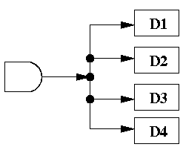
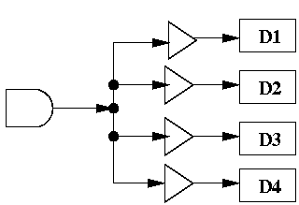
Logic Buffer Gate
Gates process 1s and 0s
0s and 1s are really electric current at certain voltages.
If not enough current, it’s hard to measure the voltage.
Current can decrease if fan out is large.
fan out is the number of devices that an output is attached to.
fan-out of 4
Use of buffers to boost current.
Notes:
AND gate above is attached to the inputs of 4 other devices. It has a fan out of 4.
If the current coming out of the AND gate is i, then assuming each of the 4 devices get equal current, then each device gets i/4 of the current.
If we put in a buffer, then the current can be “boosted” back to the original strength.

Slide 18
More Two-Input Logic Gates
Notes:
XOR – Exclusive OR
“The output is true if A OR B is true, AND if A AND B are NOT true.”

Slide 19
Multi-Input Gates
Notes:
This is just one example – there are many others.

Slide 20
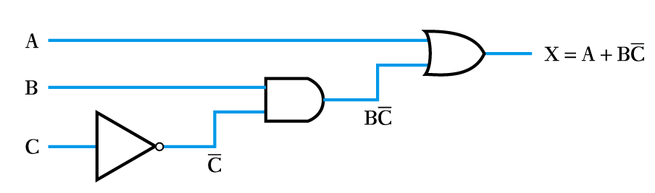
Implementing a Function from a Boolean Expression
Notes:
Can also do the process in reverse to Generate a Boolean expression from a logic diagram

Slide 21
The Logic Lab
http://www.neuroproductions.be/logic-lab/

Slide 22
Logic Levels
Discrete voltages represent 1 and 0
For example:
0 = ground (GND) or 0 volts
1 = V_{DD} or 5 volts
What about 4.99 volts? Is that a 0 or a 1?
What about 3.2 volts?
Range of voltages for 1 and 0
WHY?
Different ranges for inputs and outputs to allow for noise.
Notes:
Mapping of a continuous variable onto a discrete binary variable is done by defining logic levels.
V_{DD} – positive supply voltage
GND – Ground - In digital logic, this is nearly always the negative pin

Slide 23
What is Noise?
Anything that degrades the signal
e.g., resistance, power supply noise, coupling to neighbouring wires, etc.
Example: A gate (driver) outputs 5 V but, because of resistance in a long wire, receiver gets 4.5 V

Slide 24
Noise Margins
1
1
0
0
Noise Margins (NM)
NM_{H} = V_{OH} – V_{IH}
NM_{L} = V_{IL} – V_{OL}
Notes:
Driver produces a LOW (0) output in the range 0 to V_{OL} or a HIGH (1) output in the range V_{OH} to V_{DD}
If receiver gets input in the range 0 to V_{IL} it will consider it a LOW input (0)
If receiver gets input in the range 0 to V_{IH} it will consider it a HIGH input (1)
If due to noise, faulty components the receiver input should fall in the forbidden zone (between V_{IL} and V_{IH}) the gate behaviour is unpredictable.
Noise margin is the amount of noise that could be added to a worst-case output such that the signal can still be interpreted as a valid input.

Slide 25
Static Discipline
To avoid inputs falling into the forbidden zone, digital logic gates are designed to conform to the static discipline
With logically valid inputs, every circuit element must produce logically valid outputs.
Use limited ranges of voltages to represent discrete values.
Gates are grouped into logic families such that all gates in a logic family obey static discipline when used with other gates in the family.

Slide 26
Logic Families
Four major logic families that predominated from the 1970’s through the 1990s:
Logic Family | V_{DD} | V_{IL} | V_{IH} | V_{OL} | V_{OH}
TTL | 5 (4.75 - 5.25) | 0.8 | 2.0 | 0.4 | 2.4
CMOS | 5 (4.5 - 6) | 1.35 | 3.15 | 0.33 | 3.84
LVTTL | 3.3 (3 - 3.6) | 0.8 | 2.0 | 0.4 | 2.4
LVCMOS | 3.3 (3 - 3.6) | 0.9 | 1.8 | 0.36 | 2.7
Notes:
A logic family is a group of electronic logic gates constructed using one of several different designs, usually with compatible logic levels and power supply characteristics within a family.
Transistor–transistor logic (TTL)
Complementary metal–oxide–semiconductor logic (CMOS)
LV = Low Voltage
V_{OH}, V_{OL} – output high and low logic levels
V_{IH}, V_{IL} – input high and low logic levels

Slide 27
V_{DD} Scaling
In 1970s and 1980s, V_{DD} = 5 V
V_{DD} has dropped
Avoid frying tiny transistors
Save power
3.3 V, 2.5 V, 1.8 V, 1.5 V, 1.2 V, 1.0 V, …
Be careful connecting chips with different supply voltages.

Slide 28
Chips operate because they contain magic smoke
Proof: If the magic smoke is let out, the chip stops working.

